Slide 1
UNIT 6 SIGNALS AND DAEMON PROCESSES
DAEMON PROCESSES
Daemons that answer request for services.
Daemons are processes that live for a long time.
They are often started when the system is bootstrapped and terminate only when the system is shut down.
Because they don't have a controlling terminal, we say that they run in the background.
UNIX systems have numerous daemons that perform day-to-day activities.

Slide 2
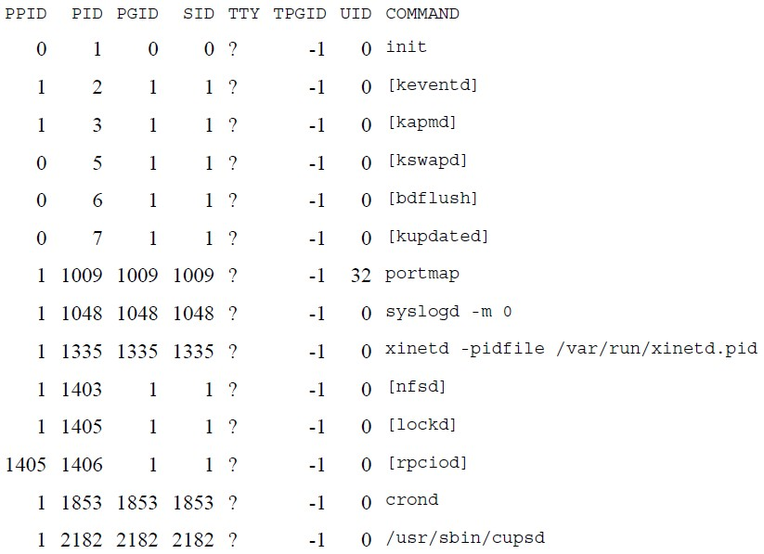
UNIT 6 SIGNALS AND DAEMON PROCESSES
DAEMON PROCESSES
Deamon Characteristics
$ps -axj

Slide 3
UNIT 6 SIGNALS AND DAEMON PROCESSES
DAEMON PROCESSES
Deamon Characteristics
Daemons run in background.
Daemons have super-user privilege.
Daemons don’t have controlling terminal.
Daemons are session and group leaders.

Slide 4
UNIT 6 SIGNALS AND DAEMON PROCESSES
DAEMON PROCESSES
Deamon Characteristics
Anything with a parent process ID of 0 is usually a kernel process started as part of the system bootstrap procedure.
Kernel processes are special and generally exist for the entire lifetime of the system.
They run with superuser privileges and have no controlling terminal and no command line.
Process ID of 1 is usually init.
It is a system daemon responsible for, among other things, starting system services specific to various run levels.

Slide 5
UNIT 6 SIGNALS AND DAEMON PROCESSES
DAEMON PROCESSES
Deamon Characteristics
keventd daemon provides process context for running scheduled functions in the kernel.
The kapmd daemon provides support for the advanced power management features available with various computer systems.
The kswapd daemon is also known as the pageout daemon.
It supports the virtual memory subsystem by writing dirty pages to disk slowly over time, so the pages can be reclaimed.
The inetd daemon (xinetd) listens on the system's network interfaces for incoming requests for various network servers.
The nfsd, lockd, and rpciod daemons provide support for the
Network File System (NFS).
The cron daemon (crond) executes commands at specified dates and times. Numerous system administration tasks are handled by having programs executed regularly by cron.
The cupsd daemon is a print spooler; it handles print requests on the system.

Slide 6
UNIT 6 SIGNALS AND DAEMON PROCESSES
DAEMON PROCESSES CODING RULES
Call umask to set the file mode creation mask to 0. The file mode creation mask that's inherited could be set to deny certain permissions.
Call fork and have the parent exit. This does several things. First, if the daemon was started as a simple shell command, having the parent terminate makes the shell think that the command is done. Second, the child inherits the process group ID of the parent but gets a new process ID, so we're guaranteed that the child is not a process group leader.

Slide 7
DAEMON PROCESSES UNIT 6 SIGNALS AND DAEMON PROCESSES
CODING RULES
Call setsid to create a new session. The process (a) becomes a session leader of a new session, (b) becomes the process group leader of a new process group, and (c) has no controlling terminal.
Change the current working directory to the root directory. The current working directory inherited from the parent could be on a mounted file system. Since daemons normally exist until the system is rebooted, if the daemon stays on a mounted file system, that file system cannot be unmounted.
Unneeded file descriptors should be closed. This prevents the daemon from holding open any descriptors that it may have inherited from its parent.

Slide 8
UNIT 6 SIGNALS AND DAEMON PROCESSES
DAEMON PROCESSES CODING RULES
6. Some daemons open file descriptors 0, 1, and 2 to /dev/null so that any library routines that try to read from standard input or write to standard output or standard error will have no effect. Since the daemon is not associated with a terminal device, there is nowhere for output to be displayed; nor is there anywhere to receive input from an interactive user.

Slide 9
UNIT 6 SIGNALS AND DAEMON PROCESSES
DAEMON PROCESSES CODING RULES
Example Program:
#include <unistd,h> #include <sys/types.h> #include <fcntl.h> int daemon_initialise( ) { pid_t pid; if (( pid = fork() ) < 0) return –1; | else if ( pid != 0) exit(0); /* parent exits */ /* child continues */ setsid( ); chdir(“/”); umask(0); return 0; }

Slide 10
UNIT 6 SIGNALS AND DAEMON PROCESSES
DAEMON PROCESSES
Error Logging
One problem a daemon has is how to handle error messages.
It can't simply write to standard error, since it shouldn't have a controlling terminal.
We don't want all the daemons writing to the console device, since on
many workstations, the console device runs a windowing system.
We also don't want each daemon writing its own error messages into a separate file.
A central daemon errorlogging facility is required.

Slide 11
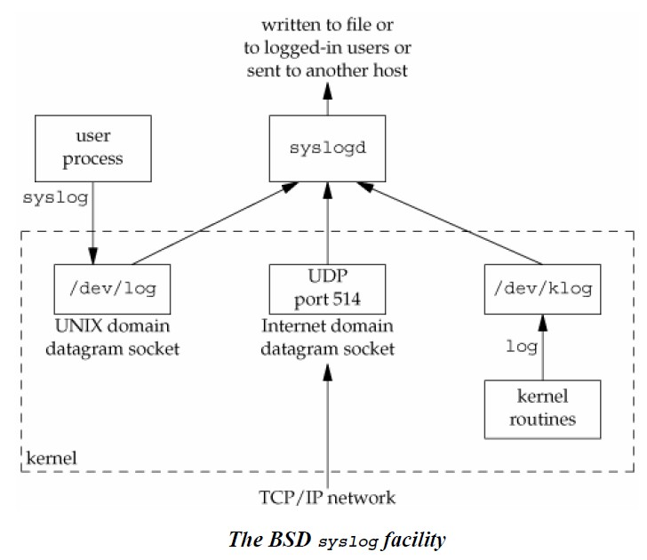
UNIT 6 SIGNALS AND DAEMON PROCESSES
DAEMON PROCESSES
Error Logging

Slide 12
UNIT 6 SIGNALS AND DAEMON PROCESSES
DAEMON PROCESSES
Error Logging
There are three ways to generate log messages:
Kernel routines can call the log function.
These messages can be read by any user process that opens and reads the
/dev/klog device.
Most user processes (daemons) call the syslog(3) function to generate log messages. This causes the message to be sent to the UNIX domain datagram socket /dev/log.
A user process on this host, or on some other host that is connected to this host by a TCP/IP network, can send log messages to UDP port 514.
The syslogd daemon reads all three forms of log messages.
On start-up, this daemon reads a configuration file, usually /etc/syslog.conf, which determines where different classes of messages are to be sent.

Slide 13
UNIT V

Slide 14
UNIT 7 INTERPROCESSES COMMUNICATION
INTORDUCTION
IPC ( InterProcess Communication)
(It is a mechanism whereby two or more processes communicate with each other to perform tasks.
These processes may interact in a client/server manner or in a peer-to- peer fashion.)

Slide 15
UNIT 7 INTERPROCESSES COMMUNICATION
INTORDUCTION
IPC ( InterProcess Communication)
The various forms of IPC that are supported on a UNIX system are as follows :
1. Half duplex Pipes | 2. Full duplex Pipes
3. FIFO’s | 4. Named full duplex Pipes
5. Message queues | 6. Shared memory
7. Semaphores | 8. Sockets 9. STREAMS
The first seven forms of IPC are usually restricted to IPC between processes on the same host.
The final two i.e. Sockets and STREAMS are the only two that are generally supported for IPC between processes on different hosts.

Slide 16
UNIT 7 INTERPROCESSES COMMUNICATION
PIPES
Pipes are the oldest form of UNIX System IPC.
Pipes have two limitations.
Historically, they have been half duplex (i.e.data flows in only one direction)
Pipes can be used only between processes that have a common ancestor.
Normally, a pipe is created by a process, that process calls fork, and the pipe is used between the parent and the child.

Slide 17
UNIT 7 INTERPROCESSES COMMUNICATION
PIPES
A pipe is created by calling the pipe function.
#include <unistd.h> int pipe(int fd[2]);
Returns: 0 if OK, –1 on error
Despite these limitations, half-duplex pipes are still the most commonly used form of IPC.
Every time we type a sequence of commands in a pipeline for the shell to execute, the shell creates a separate process for each command and links the standard output of one to the standard input of the next using a pipe.

Slide 18
UNIT 7 INTERPROCESSES COMMUNICATION
PIPES
Two file descriptors are returned through the fd argument:
fd[0] is open for reading, and fd[1] is open for writing.
The output of fd[1] is the input for fd[0].
POSIX.1 allows for an implementation to support full-duplex pipes. For these implementations,
fd[0] and fd[1] are open for both reading and writing.

Slide 19
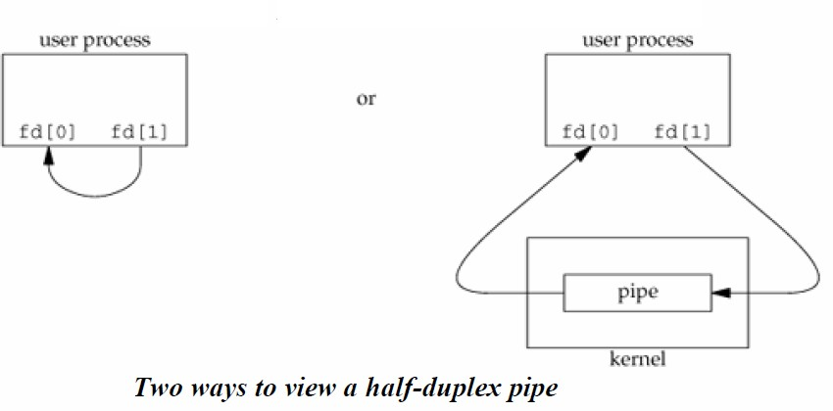
UNIT 7 INTERPROCESSES COMMUNICATION
PIPES
Two ways to picture a half-duplex pipe are shown in the given diagrams below:

Slide 20
UNIT 7 INTERPROCESSES COMMUNICATION
PIPES
The left half of the diagram shows the two ends of the pipe connected in a single process.
The right half of the diagram emphasizes that the data in the pipe flows through the kernel.
A pipe in a single process is next to useless.
Normally, the process that calls pipe then calls fork, creating an IPC channel from the parent to the child or vice versa.

Slide 21
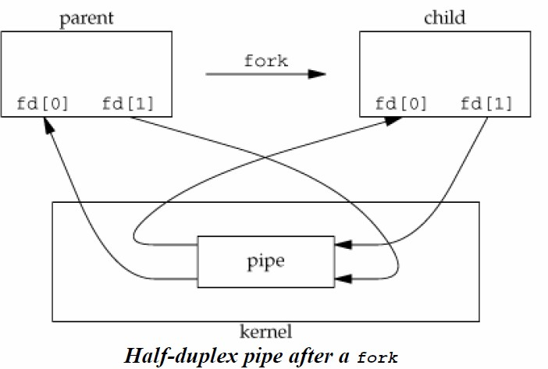
UNIT 7 INTERPROCESSES COMMUNICATION
PIPES

Slide 22
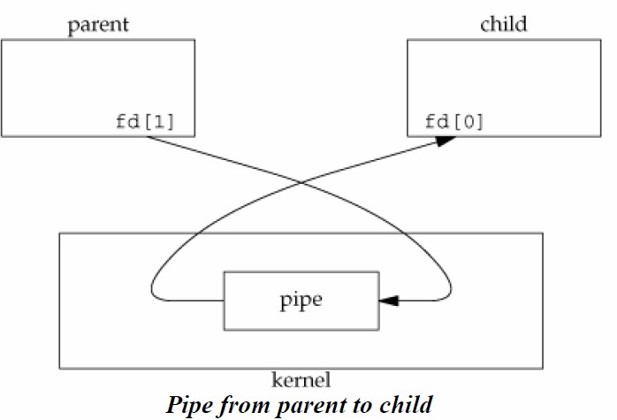
UNIT 7 INTERPROCESSES COMMUNICATION
PIPES
For a pipe from the parent to the child, the parent closes the read end of the pipe (fd[0]), and the child closes the write end (fd[1]).

Slide 23
UNIT 7 INTERPROCESSES COMMUNICATION
PIPES
For a pipe from the parent to the child, the parent closes the read end of the pipe (fd[0]), and the child closes the write end (fd[1]).
For a pipe from the child to the parent, the parent closes fd[1], and the child closes fd[0].

Slide 24
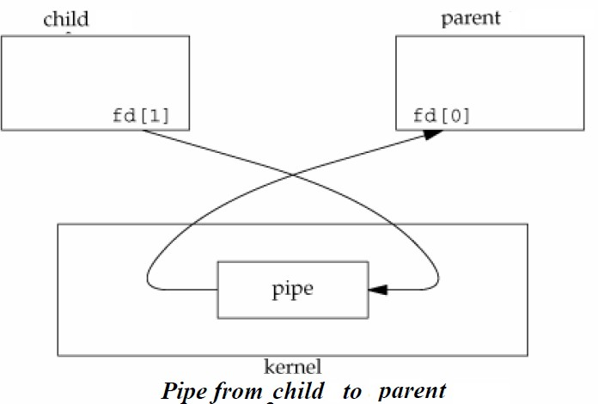
UNIT 7 INTERPROCESSES COMMUNICATION
PIPES
For a pipe from the child to the parent, the parent closes fd[1], and the child closes fd[0].

Slide 25
UNIT 7 INTERPROCESSES COMMUNICATION
PIPES
When one end of a pipe is closed, the following two rules apply.
If we read from a pipe whose write end has been closed, read returns 0 to indicate an end of file after all the data has been read
If we write to a pipe whose read end has been closed, the signal SIGPIPE is generated. If we either ignore the signal or catch it and return from the signal handler, write returns –1 with errno set to EPIPE.
write
pipe

Slide 26
UNIT 7 INTERPROCESSES COMMUNICATION
PIPES
Program to show the code to create a pipe between a parent and its child and to send data down the pipe.
 | int main(void) { int n, fd[2]; pid_t pid; char line[1000]; if (pipe(fd) < 0) perror("pipe error"); if ((pid = fork()) < 0) perror("fork error"); else if (pid > 0) { /* parent */ | close(fd[0]); write(fd[1], "hello world\n", 12); } else { /* child */ close(fd[1]); n = read(fd[0], line,1000); write(1, line, n); } exit(0); } | 67
PROF.
SYED MUSTAFA, HKBKCE

Slide 27
UNIT 7 INTERPROCESSES COMMUNICATION
Popen() and pclose() Functions
Since a common operation is to create a pipe to another process, to either read its output or send it input, the standard I/O library has historically provided the popen and pclose functions.
These two functions handle all the dirty work that we've been doing ourselves: creating a pipe, forking a child, closing the unused ends of the pipe, executing a shell to run the command, and waiting for the command to terminate.

Slide 28
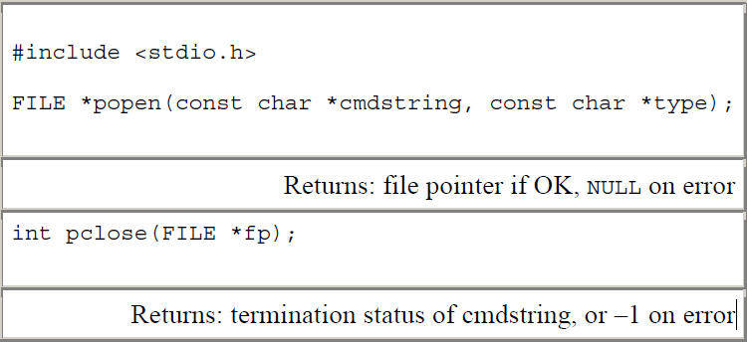
UNIT 7 INTERPROCESSES COMMUNICATION
Popen() and pclose() Functions

Slide 29
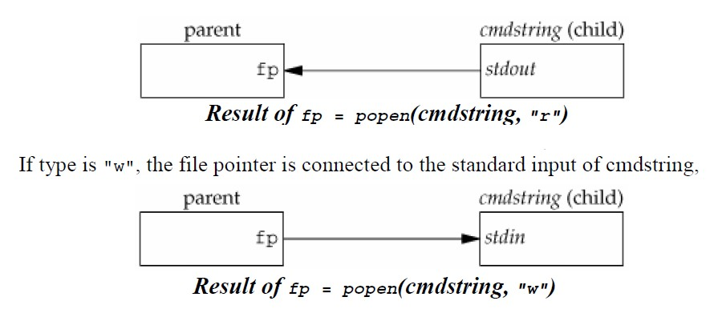
UNIT 7 INTERPROCESSES COMMUNICATION
Popen() and pclose() Functions
The function popen does a fork and exec to execute the cmdstring, and returns a standard I/O file pointer.
If type is "r", the file pointer is connected to the standard output of cmdstring

Slide 30
UNIT 7 INTERPROCESSES COMMUNICATION
Popen() and pclose() Functions
This means that the shell expands any of its special characters in cmdstring. Example:
fp = popen("ls *.c", "r"); or fp = popen("cmd 2>&1", "r");

Slide 31
UNIT 7 INTERPROCESSES COMMUNICATION
PIPES
Program to implement UNIX command redirection for “ls|sort” using popen().
int main(void)
{
FILE *pipein_fp, *pipeout_fp; char readbuf[80];
/* Create one way pipe line with call to popen() */
pipein_fp = popen("ls", "r"); if (pipein_fp== NULL)
{
perror("popen"); exit(1);
}
/* Create one way pipe line with call to popen() */
if (pipeout_fp == NULL)
{
perror("popen"); exit(1);
}
/* Processing loop */ while(fgets(readbuf, 80, pipein_fp))
fputs(readbuf, pipeout_fp);
/* Close the pipes */ pclose(pipein_fp); pclose(pipeout_fp); return(0); }
pipeout_fp = popen("sort", "w“);
PROF. SYED MUSTAFA, HKBKCE
79

Slide 32
UNIT 7 INTERPROCESSES COMMUNICATION
Coprocesses
A UNIX system filter is a program that reads from standard input and writes to standard output.
Filters are normally connected linearly in shell pipelines.
A filter becomes a coprocess when the same program generates the filter's input and reads the filter's output
The Korn shell provides coprocesses.
The Bourne shell, the Bourne-again shell, and the C shell don't provide a way to connect processes together as coprocesses.
A coprocess normally runs in the background from a shell, and its standard input and standard output are connected to another program using a pipe.

Slide 33

UNIT 7 INTERPROCESSES COMMUNICATION
Coprocesses
Whereas popen gives us a one-way pipe to the standard input or from the standard output of another process.
With a coprocess, we have two one-way pipes to the other process: one to its standard input and one from its standard output.
The process creates two pipes: one is the standard input coprocess, and the other is the standard output of the coprocess.
The diagram shows this arrangement.
of the

Slide 34
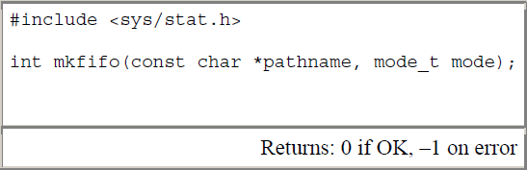
UNIT 7 INTERPROCESSES COMMUNICATION
FIFOs
FIFOs are sometimes called named pipes.
Pipes can be used only between related processes when a common ancestor has created the pipe
With FIFOs, unrelated processes can exchange data.
Creating a FIFO is similar to creating a file.
Indeed, the pathname for a FIFO exists in the file system.

Slide 35
UNIT 7 INTERPROCESSES COMMUNICATION
FIFOs
Once we have used mkfifo to create a FIFO, we open it using open().
When we open a FIFO, the non blocking flag (O_NONBLOCK) affects what happens:
In the normal case (O_NONBLOCK not specified), an open for read-only blocks until some other process opens the FIFO for writing. Similarly, an open for write-only blocks until some other process opens the FIFO for reading
If O_NONBLOCK is specified, an open for read-only returns immediately. But an open for write-only returns 1 with errno set to ENXIO if no process has the FIFO open for reading.

Slide 36
UNIT 7 INTERPROCESSES COMMUNICATION
FIFOs
There are two uses for FIFOs.
FIFOs are used by shell commands to pass data from one shell pipeline to another without creating intermediate temporary files.
FIFOs are used as rendezvous points in client–server applications to pass data between the clients and the servers.

Slide 37
UNIT 7 INTERPROCESSES COMMUNICATION
FIFOs
Example Client-Server Communication Using a FIFO
A single FIFO can’t be used, as the clients would never know when to read their response versus responses for other clients.
One solution is for each client to send its process ID with the request.
The server then creates a unique FIFO for each client, using a pathname based on the client’s process ID.
For example, the server can create a FIFO with the name /home/ ser.XXXXX, where XXXXX is replaced with the client’s process ID.
This arrangement works, although it is impossible for the server to tell whether a client crashes.

Slide 38
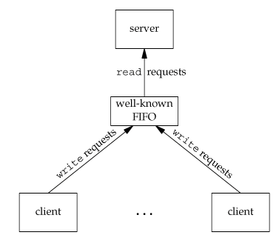
UNIT 7 INTERPROCESSES COMMUNICATION
FIFOs
Example Client-Server Communication Using a FIFO
This causes the client-specific FIFOs to be left in the file system.
The server also must catch SIGPIPE, since it’s possible for a client to send a request and terminate before reading the response, leaving the client- specific FIFO with one writer (the server) and no reader.
Clients sending requests to a server using a FIFO

Slide 39
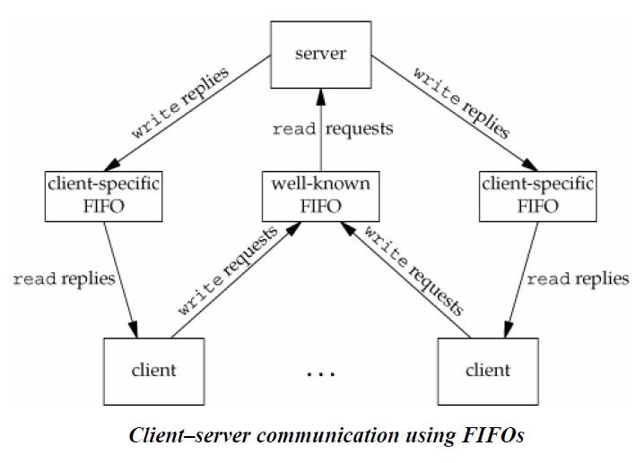
UNIT 7 INTERPROCESSES COMMUNICATION
FIFOs
Example Client-Server Communication Using a FIFO

Slide 40
UNIT 7 INTERPROCESSES COMMUNICATION
Message Queues
A message queue is a linked list of messages stored within the kernel and identified by a message queue identifier.
A new queue is created or an existing queue opened by msgget().
New messages are added to the end of a queue by msgsnd().
Every message has a positive long integer type field, a non-negative length, and the actual data bytes (corresponding to the length), all of which are specified to msgsnd() when the message is added to a queue.
Messages are fetched from a queue by msgrcv().
We don't have to fetch the messages in a first-in, first-out order.
Instead, we can fetch messages based on their type field.

Slide 41
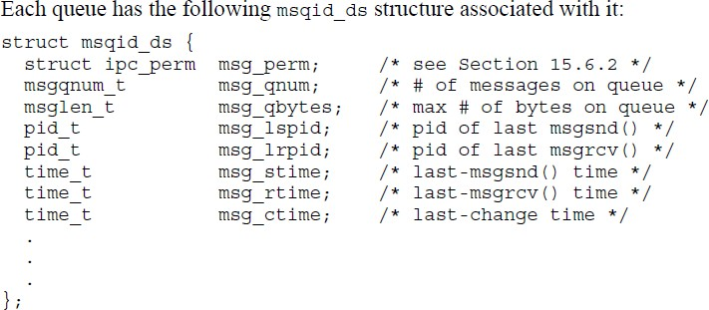
UNIT 7 INTERPROCESSES COMMUNICATION
Message Queues
This structure defines the current status of the queue.
The members shown are the ones defined by the Single UNIX Specification.

Slide 42
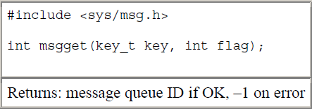
UNIT 7 INTERPROCESSES COMMUNICATION
Message Queues
The first function normally called is msgget() to either open an existing queue or create a new queue.

Slide 43
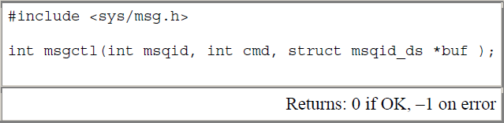
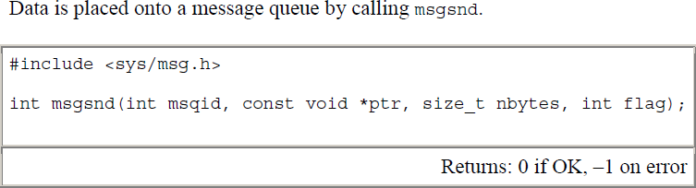
UNIT 7 INTERPROCESSES COMMUNICATION
Message Queues
The msgctl function performs various operations on a queue.

Slide 44
UNIT 7 INTERPROCESSES COMMUNICATION
Message Queues
Each message is composed of a positive long integer type field, a non-negative length
(nbytes), and the actual data bytes (corresponding to the length).
Messages are always placed at the end of the queue.
The ptr argument points to a long integer that contains the positive integer message type, and it is immediately followed by the message data.
There is no message data if nbytes is 0. If the largest message we send is 512 bytes, we can define the following structure:
struct mymesg {
long mtype; /* positive message type */
char mtext[512]; /* message data, of length nbytes */
};
The ptr argument is then a pointer to a mymesg structure.
The message type can be used by the receiver to fetch messages in an order other than
first in, first out.

Slide 45
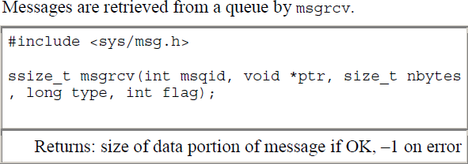
UNIT 7 INTERPROCESSES COMMUNICATION
Message Queues

Slide 46
UNIT 7 INTERPROCESSES COMMUNICATION
Message Queues
#include <stdio.h> #include <sys/types.h> #include <sys/ipc.h> #include <sys/msg.h>
int main()
{
int msqid;
msqid = msgget((key_t)5, IPC_CREAT | IPC_EXCL | 0777); if(-1 == msqid) {
perror("msgget:");
exit(1);
}
printf("msgid = %d\n",msqid);
}

Slide 47
UNIT 7 INTERPROCESSES COMMUNICATION
Message Queues
#include <sys/types.h> #include <sys/ipc.h> #include <sys/msg.h> struct msgbuf{ long mtype; char mtext[40]; }; int main() { int msqid, len, ret; struct msgbuf msgsend={0,"\0"}; msqid = msgget((key_t)5, IPC_CREAT | 0666); if(-1 == msqid){ perror("msgget:"); exit(1); } | printf("Enter message type: \n"); scanf("%d",&msgsend.mtype); printf("Enter message text\n"); //make use of fgets() if u want to send msg with spaces scanf("%s", msgsend.mtext); len = strlen(msgsend.mtext); ret = msgsnd(msqid, &msgsend, len, 0); if(-1 == ret) { perror("msgsnd:"); exit(1); } else printf("message sent\n"); }
PROF.
SYED MUSTAFA, HKBKCE 99

Slide 48
UNIT 7 INTERPROCESSES COMMUNICATION
Message Queues
 | #include <sys/types.h> #include <sys/ipc.h> #include <sys/msg.h> struct msgbuf{ long mtype; char mtext[40]; }; main() { int msqid, len, ret, type; struct msgbuf msgread={0, "\0"}; fflush(stdin); msqid = msgget((key_t)5,0); if(-1 == msqid) { | exit(1); } printf("Enter the message no:\n"); scanf("%d", &type); len = sizeof(msgread.mtext); ret = msgrcv(msqid, &msgread, len, type, IPC_NOWAIT ); printf("ret = %d\n", ret); if(-1 == ret){ perror("msgrcv:"); exit(1); } else printf("message type = %d message text = %s\n", msgread.mtype, msgread.mtext);
 | perror("msgget:"); | }
PROF. SYED MUSTAFA, HKBKCE 100

